Slide 1

Sreyas Institute of Engineering and Technology
An Autonomous Institution
Approved by AICTE, Affiliated to JNTUH
Accredited by NAAC-A Grade, NBA (CSE, ECE & ME) & ISO 9001:2015 Certified
Department of Computer Science and Engineering
A REAL-TIME PROJECT REVIEW
On
Smart Queue and Appointment Management System
BACHELOR OF TECHNOLOGY
IN
COMPUTER SCIENCE AND ENGINEERING
BY
24VE1A05A9 SHREE PRANAV
24VE1A05A2 Kaveri Podisheti
24VE1A0569 B. Anjali Devi
24VE1A0575 CH. Chandu
Under the Guidance of -
Dr .G J BHARAT KUMAR

Slide 2
Abstract
The Smart Queue and Appointment Management System is a web-based, cloud-enabled application that helps manage appointments and queues in places such as hospitals, banks, and government offices. Users can book appointments online, receive queue tokens, and view real-time queue status along with estimated waiting time, which helps reduce overcrowding and long waits. The system supports multiple services and departments and stores data securely in a cloud-based MySQL database. It is built using Java Servlets for the backend and HTML, CSS, and JavaScript for the frontend, making it efficient, user-friendly, and easily scalable for future features like priority handling, notifications, and analytics.

Slide 3
Existing System
In many hospitals, banks, and government offices, queue and appointment management is still handled using manual or semi-manual methods. Users usually have to visit the service center in person to book appointments or collect tokens, which are often issued using paper slips or simple token machines. They are then required to wait on-site until their turn arrives. These systems do not offer real-time queue updates or waiting time estimates. Handling delays, cancellations, or emergency cases is done manually by staff, which often results in confusion, inefficiency, and longer waiting times.

Slide 4
Demerits of existing system
No Real-Time Queue Updates – Users are not informed about queue progress or delays.
-Long and Uncertain Waiting Time – Users have to wait physically without knowing when their turn will come.
-No Online Booking – Appointments must be taken in person, causing crowding at service counters.
-No Real-Time Queue Updates – Users are not informed about queue progress or delays.
-Manual Errors and Data Issues – Paper-based systems often lead to mistakes, duplication, or data loss.
-Inefficient Resource Management – Staff cannot properly manage counters or service flow due to lack of insights.
-Poor Scalability and User Convenience – Traditional systems struggle with high volume and force users to stay on-site.

Slide 5
Proposed System
The proposed system is a Smart Queue and Appointment Management System, a web-based application that automates appointment booking and queue handling for places such as hospitals, banks, and government offices. Users can book appointments online, receive queue tokens, and view real-time queue status with estimated waiting time. An admin module enables administrators to monitor the queue, manage appointments, and control service flow efficiently. The system supports multiple services and departments and securely stores data in a cloud-based MySQL database. Developed using Java Servlets for the backend and HTML, CSS, and JavaScript for the frontend, the system reduces manual work and improves overall service efficiency.

Slide 6
Merits of the proposed system
-Reduced Waiting Time – Users can view real-time queue status and estimated waiting time.
-Online Appointment Booking – Appointments can be booked remotely, reducing overcrowding.
-Efficient Queue Management – Admins can monitor and control the queue through an admin panel.
-Cloud-Based Database – Data is securely stored and accessible from anywhere.
-Real-Time Updates – Live queue progress improves transparency and user experience.
-Scalable for Multiple Services – Supports hospitals, banks, and other service environments.
-Reduced Manual Work & Errors – Automation minimizes paperwork and human errors.

Slide 7
Software and hardware requirements
Software Requirements | Hardware Requirements
Frontend: HTML, CSS, JavaScript | Processor – Intel i3 / AMD Ryzen 3 or higher
Backend : Java(using Apache Tomcat) | RAM – Minimum 4 GB (8 GB recommended)
Cloud Database: MySQL (Supabase) | Storage – 10 GB free disk space
OS/web browser :Windows OS/ Any | Internet Connection – Required (for cloud database access)

Slide 8
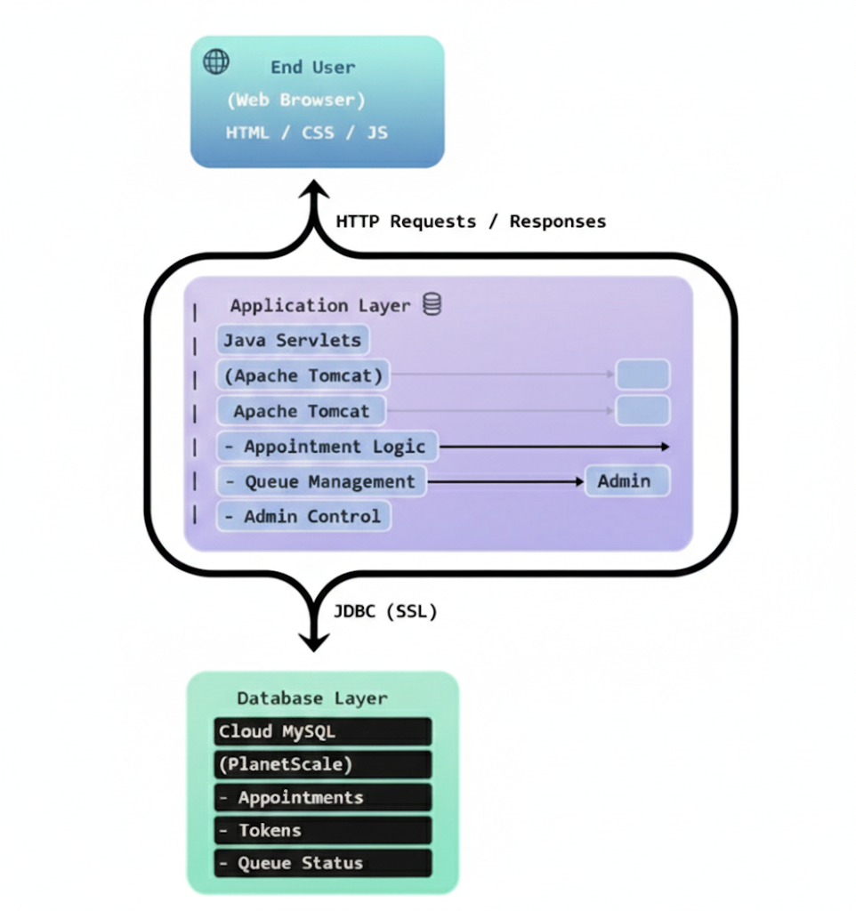
Software Architecture diagram

